Slide 1
ECL Workshop
Day 1 and Day 2

Slide 2
Math Functions
There are different Math functions supported in ECL. Some of them are:
ABS
ROUND
SIN
COS
TAN
AVE
MIN
MAX
EXP
LOG
RANK
POWER
SQRT
And so on..

Slide 3
Standard Library Functions
There are different String Handling functions supported in ECL. Some of them are:
CleanSpaces
Contains
CountWords
EndsWith
ExcludeNthWord
Extract
Find, FindCount, FindReplace
Reverse
SplitWords
ToLowerCase, ToTitleCase, ToUpperCase
And so on..

Slide 4
Standard Library Functions (contd.)
There are also different Time and Date Handling functions supported in ECL. Some of them are:
Today
Year, Month, Day
CurrentTime
Hour, Minute, Second
IsLeapYear, IsDateLeapYear
IsValidDate
FromStringToDate
DaysBetween
And so on..

Slide 5
ECL User Defined Functions
The FUNCTION structure allows you to pass parameters to a set of related attribute definitions.
Syntax:
[resulttype] funcname (parameterlist) := FUNCTION
code
RETURN retval;
END;

Slide 6
Lab Exercise 1
Create an ECL function to return maximum of Two Values.
max_val(num1,num2)
Create an ECL function to check whether the number is in the given range.
IsInRange(val,from,to)
It should return the following based on the inputs:
In Range (for val between from and to)
More than right limit (for val greater than to)
Less than left limit (for val less than from)

Slide 7
SORT Function
Syntax:
SORT(recordset,value)
recordset – The set of records to process.
value – An expression or key field in the recordset on which to sort. A leading minus sign (-) indicates a descending order sort. You may have multiple value parameters to indicate sorts within sorts.
The SORT function orders the recordset according to the values specified. Any number of value parameters may be supplied, with the leftmost being the most significant sort criteria. A leading minus sign (-) on any value parameter indicates a descending sort for that one parameter.

Slide 8
DEDUP Function
Syntax:
DEDUP(recset [,condition [,ALL][KEEP n] [,keep]])
recset – The set of records to process.
condition – The expression that defines “duplicate” records.
ALL –Matches all records to each other using the condition, not just adjacent records.
KEEP n –Specifies keeping n number of duplicates. The default is 1.
keep –LEFT (the default) keeps the first and RIGHT keeps the last
The DEDUP function removes duplicate records from the recordset. The condition defines what constitutes “duplicate” records.

Slide 9
DEDUP Function (contd.)
Before understanding DEDUP, lets understand the LEFT and RIGHT Keywords.
The LEFT and RIGHT keywords qualify which record a field is from in those operations that use pairs of records, such as DEDUP, JOIN, etc. This helps prevent any code ambiguity for the compiler.
In a single dataset, the LEFT pointer initially points to NULL, and RIGHT pointer points to the first record. After each iteration, these pointers will be incremented to point to the next records.
But while using JOIN, the LEFT pointer points to a record in the first dataset, and the RIGHT pointer points to the corresponding record in the second dataset.
By default, DEDUP keeps the LEFT record, if the condition is satisfied, but if mentioned RIGHT, it will keep the RIGHT record, discarding the LEFT one.

Slide 10
TABLE Function
Syntax:
TABLE(recordset, format [,expression])
recordset – The set of records to process.
format – The RECORD structure of the output records.
expression – The "group by" clause for crosstab reports. Multiple comma-delimited expressions create one logical "group by" clause.
The TABLE function is similar to OUTPUT, but instead of writing records to a file, it outputs those records into a new memory table (a new dataset in the supercomputer). The new table inherits any implicit relationality the recordset has unless an expression is present. The new table is temporary, and exists only while the query is running.
So TABLE is basically used for vertical slicing of the dataset, which allows you to work only with the fields you actually need.

Slide 11
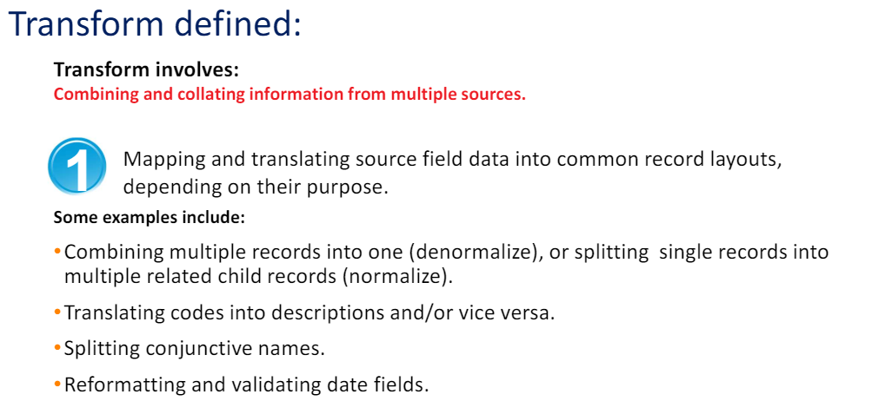
TRANSFORM

Slide 12
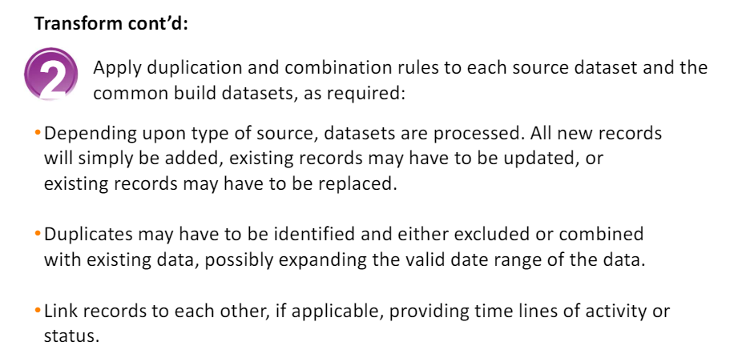
TRANSFORM

Slide 13
TRANSFORM
Syntax:
resulttype funcname( parameterlist ) := TRANSFORM
SELF.outfield := transformation;
END;
resulttype – The name of a RECORD structure definition specifying the output format of the function.
funcname – The name of the function the TRANSFORM structure defines.
parameterlist – The value types and labels of the parameters that will be passed to the TRANSFORM function.
SELF – Indicates the resulttype structure.
outfield – The name of a field in the resulttype structure.
transformation – An expression specifying how to produce the value assigned to the outfield.
The transform function must take at least one parameter: a LEFT record of the same format as the recordset. It may take an optional second parameter: an integer COUNTER specifying the number of times the transform has been called.

Slide 14
PROJECT Function
Syntax:
PROJECT(recordset, transform)
recordset – The set of records to process.
transform – The TRANSFORM function to call for each record in the recordset.
The PROJECT function processes through all the records in the recordset performing the transform function on each record in turn. The resulting record format can be different from the input.

Slide 15
ITERATE Function
Syntax:
ITERATE(recordset, transform)
recordset – The set of records to process.
transform – The TRANSFORM function to call for each record in the recordset.
The ITERATE function processes sequentially through all records in a recordset one pair of records at a time, performing the transform function on each pair in turn. The LEFT record passed to the transform is always the result record from the previous iteration, making the first left record always all blanks and/or zeroes.
The transform function must take at least 2 parameters: a LEFT record and a RIGHT record that must both be of the same format as the resulting recordset. So the input and output recordset must be same for ITERATE.

Slide 16
Lab Exercise 2
Generate a dataset, which contains the parameters lastname, and the count of persons having the same lastname. (Hint: Use TABLE and GROUP)
Generate a Dataset containing the following columns:
ID – Generate unique ID using Counter
FullName – Combination of Firstname, middlename and lastname
Address – Combination of Street, City, State and Zip Code
(Hint: Use PROJECT function)

